Slide 1



Generative AI Newsletter
Slack Chanel: #GENAI
February 7, 2024
What You Will Read:
Page 2: Top News Of The Week
Page 3: Latest Large Language Model Paper
Page 4: TOP PUBLICATION
Page 5: Top LLM GitHub Repos
Page 6: Openai’s GPT Store
Page 7: Be A Prompt Engineer
Page 8: GLOSSARY
Latest NEWS/Article and Paper on GENRATIVE AI
As we enter the new year, we are thrilled to announce that our company has experienced significant growth and success in Q1 2023.
Our hardworking team has successfully implemented new strategies and projects, resulting in an increase in revenue and market share.
THIS CAN BE FILLED WITH A
1
INTRODUCTION

Slide 2




Adept Debuts Fuyu-Heavy: A Cutting-Edge Multimodal Model for Digital Agents
Adept has debuted Fuyu-Heavy, emerging as the third most proficient multimodal model, particularly distinguished for its user interface comprehension. It surpasses Google's Bard Gemini Pro in the MMMU benchmark and equals the text-only performance of its larger counterparts, boasting efficient text and image processing capabilities, which highlight its versatility and promise for various digital applications.
OpenAI Unveils Latest Embedding Models and Enhancements to API
OpenAI has unveiled its latest embedding models, text-embedding-3-small/large, alongside updates to GPT-4/3.5 Turbo, reductions in pricing, and improvements to API management features. The new text-embedding-3-small/large models demonstrate superior performance on MIRACL (44.0%/54.9%) and MTEB (62.3%/64.6%) benchmarks, offering scalability, cost-effectiveness, and enhanced dimensions.
Google Announces Bard Gemini Pro, Competing with GPT-4 in Human Assessments
Google has launched Bard Gemini Pro, a model that equals GPT-4's performance in human assessments, securing the second position in Chatbot Arena rankings, above GPT-4 versions from 03/14 and 06/13, yet below GPT-4 Turbo. Based on feedback from 3,000 users, this achievement underscores the model's competitive edge, with the possibility of ranking fluctuations as more evaluations are gathered.
Hugging Face and Google Forge Alliance for Open AI Development
Hugging Face and Google Cloud have formed an alliance to foster open AI model integration with cloud computing services. This collaboration aims to streamline AI development by leveraging Google's Vertex AI, GKE, and the latest computing hardware (TPU v5e, A3 VMs, C3 VMs), enhancing the efficiency of training, fine-tuning, and deploying AI applications.
2
Link:
TOP NEWS OF THE WEEK

Slide 3
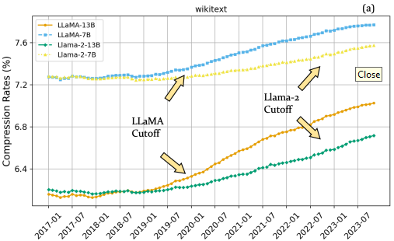
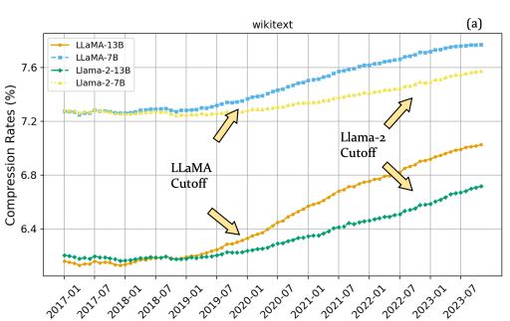
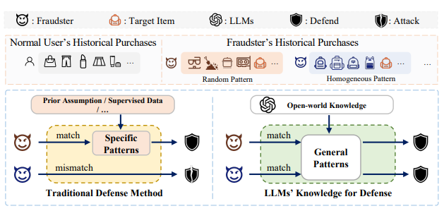
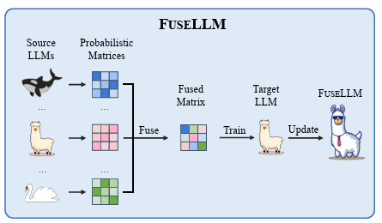
Knowledge Fusion of LLM
Knowledge Fusion of LLMs - proposes FuseLLM with the core idea of externalizing knowledge from multiple LLMs and transferring their capabilities to a target LLM; leverages the generative distributions of source LLMs to externalize both their collective knowledge and individual strengths and transfer them to the target LLM through continual training; finds that the FuseLLM can improve the performance of the target model across a range of capabilities such as reasoning, common sense, and code generation. The paper by Fanqi Wan et al. explores a cost-effective strategy called knowledge fusion for integrating the capabilities of pre-trained large language models (LLMs) into a single, more powerful model.
Full Article: https://arxiv.org/pdf/2401.10491.pdf
Code: https://github.com/fanqiwan/FuseLLM
Model Evaluation Through Compression
This paper proposes a lossless data compression-based evaluation method to measure the generalization and robustness of large language models. The method tests how well the models' predictive abilities extend beyond their training cutoff date by collecting comprehensive test data spanning several years. The results show that models' compression performance significantly decreases after their cutoff date, indicating a decline in generalization. Models like Mistral and Llama-2 demonstrate a good balance between performance and robustness. The models struggle to generalize on news and code data but perform well on arXiv papers.
Full Article: https://arxiv.org/pdf/2402.00861v1.pdf
LLM for Robust Sequential Recommendation vs Poisoning Attacks
The paper proposes LoRec, a framework that integrates large language models (LLMs) to enhance the robustness of sequential recommender systems against poisoning attacks. Poisoning attacks involve injecting fraudulent users into the training data to manipulate learned patterns in recommender systems. Traditional defense strategies for poisoning attacks are limited in their ability to handle unknown attack types, but LLMs offer the potential to detect unknown fraudsters using their expansive knowledge. LoRec employs LLM-enhanced calibration to mitigate the impact of fraudsters. The framework demonstrates significant improvements in the robustness of sequential recommender systems in various experiments. LLMs have shown remarkable capabilities in various applications, and LoRec extends their potential to the field of recommendation systems. The integration of LLMs in defense strategies expands their effectiveness beyond known attacks and enhances their ability to detect unknown attacks.
Full Article: https://arxiv.org/pdf/2401.17723v1.pdf
3
LATEST LARGE LANGUAGE MODEL PAPER

Slide 4
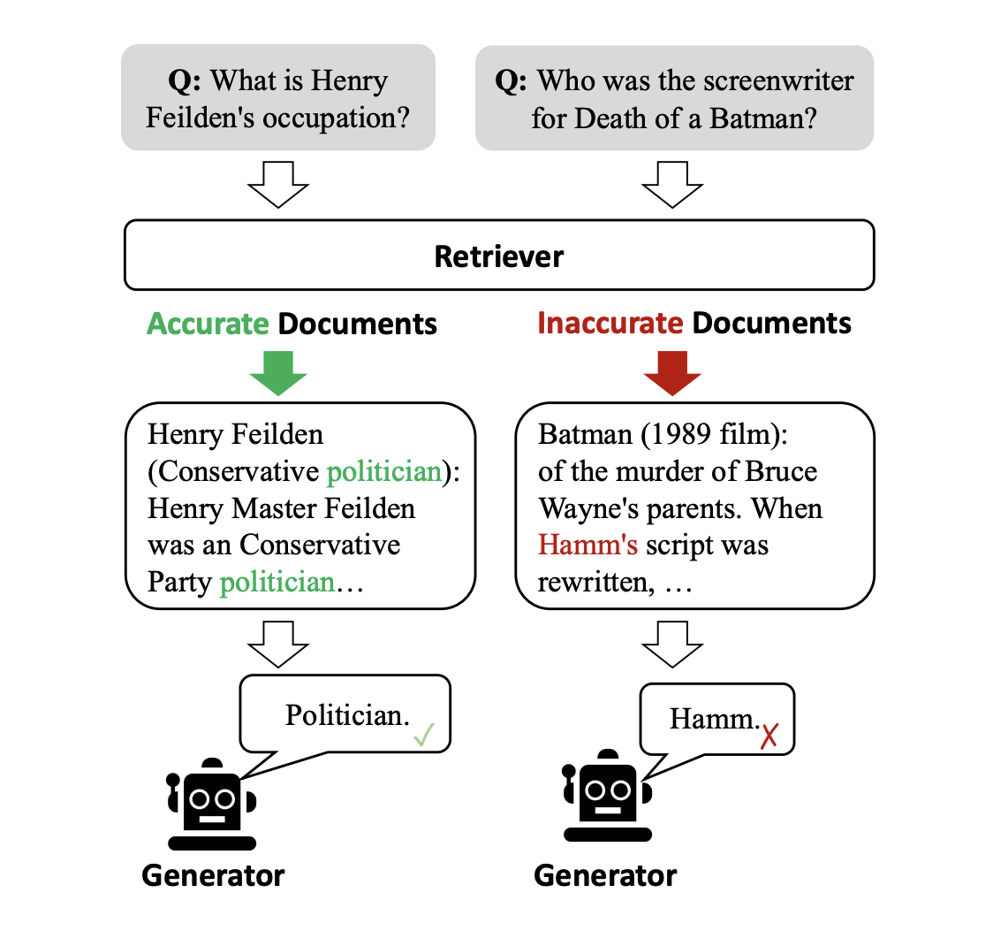
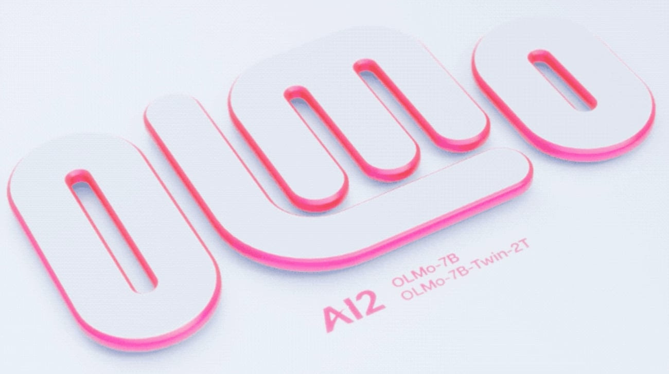
What's New:
AI2's OLMo introduces a 7 billion parameter model, outperforming Llama 2 in generative tasks, with comprehensive training data, code, and over 500 checkpoints per model, all under the Apache 2.0 License, promoting transparency and collaboration in AI.
Problem:
The AI field lacks open, detailed models allowing comprehensive study and innovation. Researchers need full access to models, training data, and tools to explore AI's potential and understand its impact thoroughly.
Solution:
AI2 developed OLMo, providing complete resources including training data, code, and model weights. They used a bias-free design, SwiGLU activation, Rotary positional embeddings, and a secure BPE-based tokenizer. The model underwent extensive training on 2 trillion tokens, ensuring robust performance and detailed checkpoints for analysis.
Results:
OLMo achieved strong performance in text generation and reading comprehension, slightly leading in generative tasks like truthfulQA compared to Llama 2, but falling just short in some question-answering tasks. Its open-source nature and comprehensive documentation empower ongoing AI research and development.
4
https://huggingface.co/allenai/OLMo-7B
TOP PUBLICATION

Slide 5
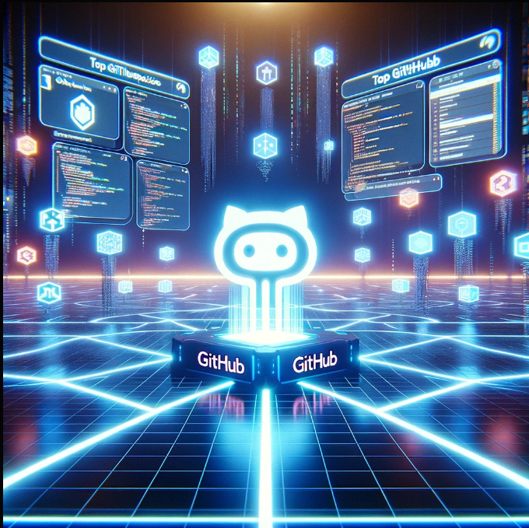
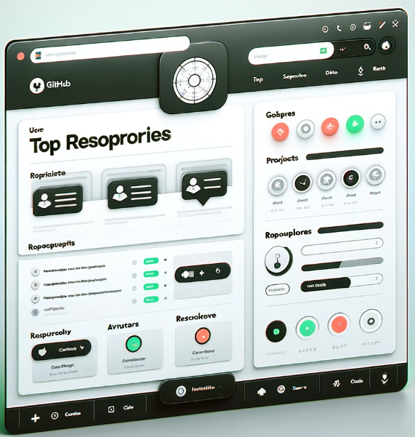
RPG-DiffusionMaster (☆ 1k)
The RPG framework enables text-to-image generation using multimodal LLMs, supporting high-resolution outputs and customizable regional diffusion. It integrates base diffusion models like SD v1.4-v2.1 and supports local LLMs with over 13 billion parameters, optimizing for computational efficiency and image quality.
https://github.com/YangLing0818/RPG-DiffusionMaster
Stanfordnlp / dspy (☆ 5.5k)
DSPy framework enables the optimization of LM prompts and weights, streamlining the integration of LMs in complex systems. It systematically adjusts program parameters, allowing LMs like GPT-3.5 or GPT-4 to perform tasks more reliably by reducing failure rates and enhancing quality.
https://github.com/stanfordnlp/dspy
LLMLingua (☆ 2.6k)
LLMLingua and LongLLMLingua compress prompts for LLMs like GPT-4, reducing token count by up to 20x, enabling efficient inference and longer context processing with minimal performance loss, and integrating seamlessly into LlamaIndex for enhanced RAG performance.
https://github.com/microsoft/LLMLingua
OLMo (☆ 167)
Arguably the biggest development in open-source LLMs yet. OLMo, a state-of-the-art open language model by AI2, offers training and experimentation frameworks on Hugging Face and GitHub. It includes variants at 7B and 1B scales, trained on 2T+ tokens, with full training data, model weights, and evaluation code.
https://github.com/allenai/OLMo
Depth-Anything (☆ 3.9k)
Tik Tok just released Depth Anything, a powerful depth estimation foundation model that can deal with any images under any circumstances.
https://github.com/LiheYoung/Depth-Anything
Depth Anything is trained on 1.5M labeled images and 62M+ unlabeled images jointly, it improves zero-shot and in-domain depth prediction, refines ControlNet, and transfers to semantic segmentation.
5
TOP LLM GITHUB REPOS

Slide 6
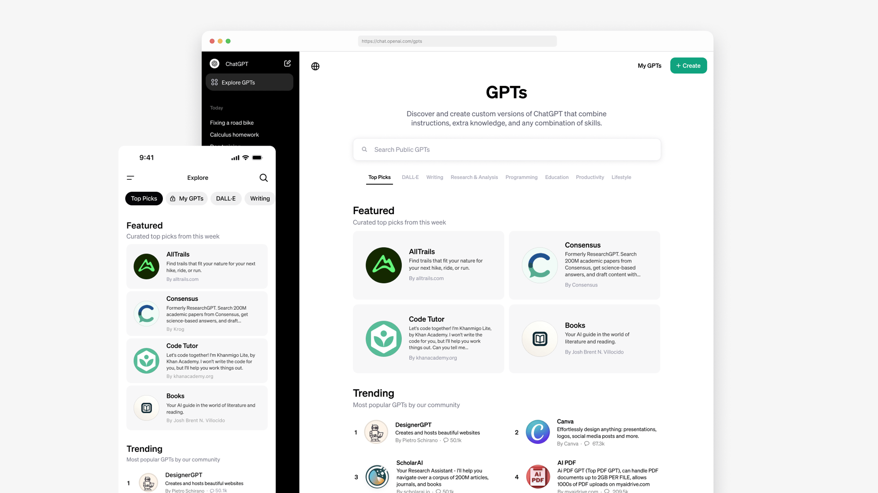
OpenAI's GPT Store
OpenAI is calm to launch the GPT Store, an innovating platform, between January 8 and 13, 2024. This initiative facilitates the monetization of custom GPT models, enabling creators to develop income from their innovative AI solutions without needing coding expertise. The GPT Store, emerging from OpenAI's commitment to democratizing AI, offers a unique mixture of creative freedom and financial incentives for developers using the GPT-4 model.
However, the path to this launch encountered delays, partly due to a leadership transition within OpenAI, underscoring the challenges of pioneering in the AI domain.
Simultaneously, the introduction of the GPT Store raises concerns about data privacy and security, as third-party developers can potentially access and misuse personal information, despite OpenAI's assurances of chat data protection. The effectiveness of OpenAI's review process in maintaining the security and privacy standards of the original ChatGPT remains uncertain, with the potential for harmful or data-collecting bots to exploit the platform. This dual narrative underscores the
excitement for AI innovation and accessibility, balanced by cautionary tales of data security within an expanding ecosystem.
As the tech world anticipates the GPT Store's impact, it represents a significant milestone in AI's integration into daily life, promising a year of continued AI adoption across industries. Nonetheless, the conversation around ensuring user data protection in this new era of AI monetization continues, reflecting the complex interplay between technological advancement and the imperative of safeguarding personal information.
The store offers a wide range of GPTs developed by partners and the community in categories such as DALL·E, writing, research, programming, education, and lifestyle. It highlights new featured GPTs weekly from various partners like AllTrails, Consensus, Khan Academy’s Code Tutor, Canva, Books, and the CK-12 Flexi AI tutor. Furthermore, a GPT builder revenue program is set to launch in Q1, initially for US builders, based on user engagement with their GPTs. The announcement also introduces the ChatGPT Team plan, offering a private section in the GPT Store for team customers, and mentions upcoming availability and enhanced admin controls for ChatGPT Enterprise customers. The use of conversations with GPTs by Team and Enterprise plans for model improvement is explicitly negated.
6
https://openai.com/blog/introducing-the-gpt-store
READING

Slide 7



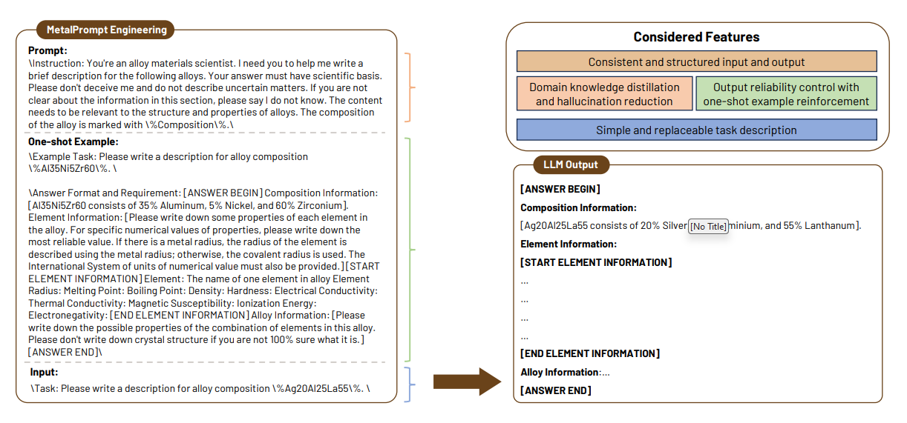
A Prompt-Engineered LLM, Deep Learning Workflow for Classification
A general approach for materials classification using large language models (LLMs), prompt engineering, and deep learning algorithms. The effectiveness of this approach in classifying metallic glasses, achieving significant improvements in prediction accuracy compared to conventional classification models. The below showcase the design of "MetalPrompt" for optimizing LLM inputs, composed of three sections: a prompt section to focus the LLM on domain-specific knowledge and reduce hallucinations, a one-shot example section to ensure consistent output structure and integrate relevant information, and an input section designed for simplicity and interchangeability to avoid disruption from irrelevant details. The output targets three information levels: alloy composition, elemental thermodynamic properties, and alloy physical and chemical properties. Emphasis symbols and specific markers are used to aid the LLM in recognizing important information and structuring the input. Supplementary figures demonstrate the inconsistency and hallucinations in outputs without "MetalPrompt," highlighting its effectiveness in enhancing output structure and relevance. Special emphasis symbols (e.g., "\," "%composition%") are used to highlight critical information and help the model recognize the structure in the input.
7
https://arxiv.org/pdf/2401.17788v1.pdf
BE A PROMPT ENGINEER

Slide 8

Large Language Model (LLM):
A deep learning model trained on vast text data to capture the nuances of natural language.
Example: GPT (Generative Pre-trained Transformer), which can generate coherent and contextually relevant text based on a given prompt.
LLM Hallucination:
This occurs when an LLM generates content that is off-topic, contradictory, or factually incorrect.
Example: If asked about the capital of France, the model incorrectly states "Barcelona" as being the capital.
Prompt Engineering:
Crafting input text to effectively direct the model towards generating specific outputs.
Example: To generate a poem, the prompt might include the style, theme, and a few starting words to guide the generation.
Chain-of-thoughts:
This method improves complex reasoning by guiding the model through a series of logical steps towards a solution.
Example: For a math problem, "What is the sum of 8 and 4, then multiplied by 2?" the chain-of-thought would be "8 + 4 = 12. 12 * 2 = 24.“
Few-shot Learning:
A machine learning technique where the model makes predictions with minimal training data.
Example: Given just a few images of cats and dogs, the model learns to classify an unseen image as either a cat or a dog.
8
GLOSSARY

